Slide 1


Proof in Practice: Evaluating Evidence (and Navigating Digital Traps)
André Pohlmann
Member of the Boards of Appeal
21 May 2026

Slide 2
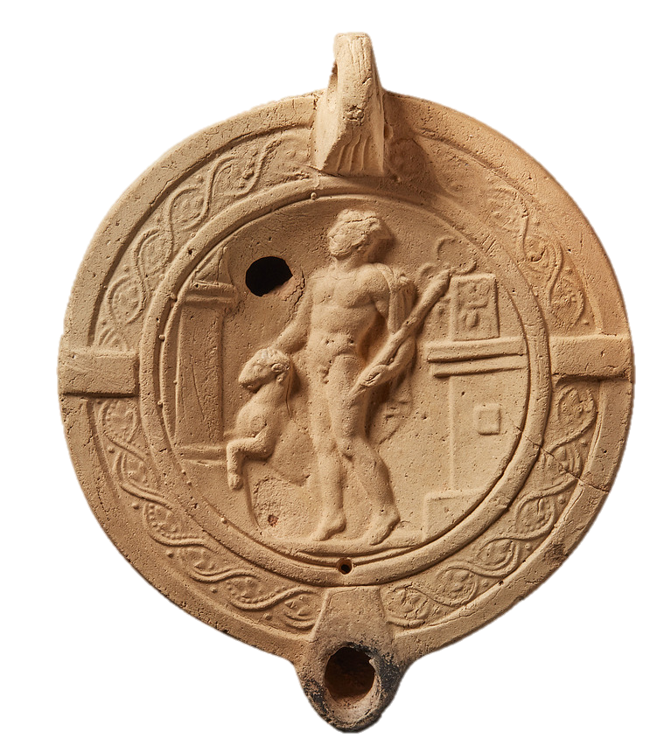
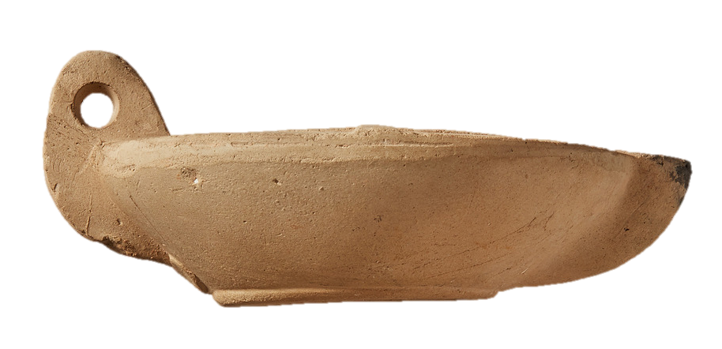
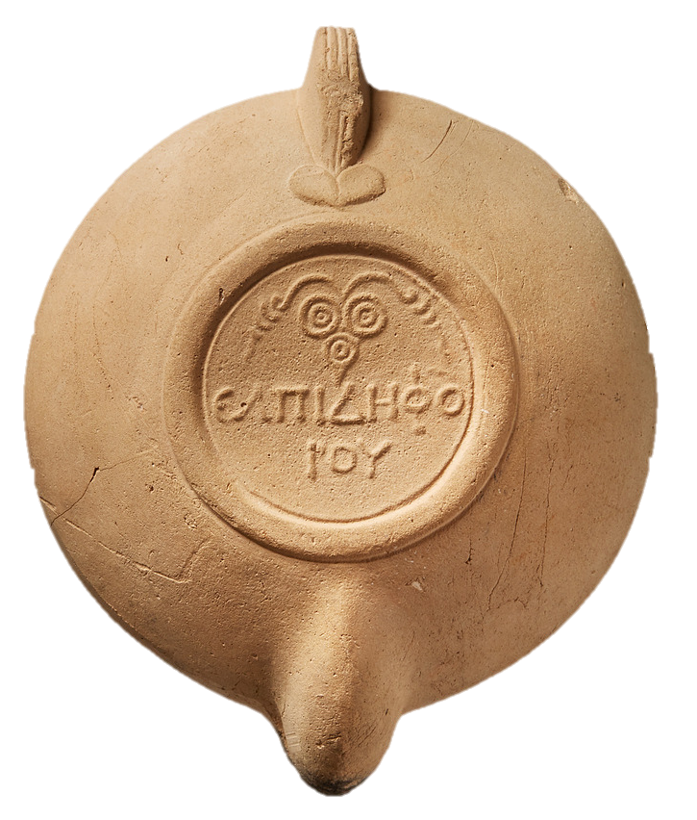

© ASCSA Digital Collections https://agora.ascsa.net/id/agora/card/l-2810-1) / Agora Object L 2810

Slide 3
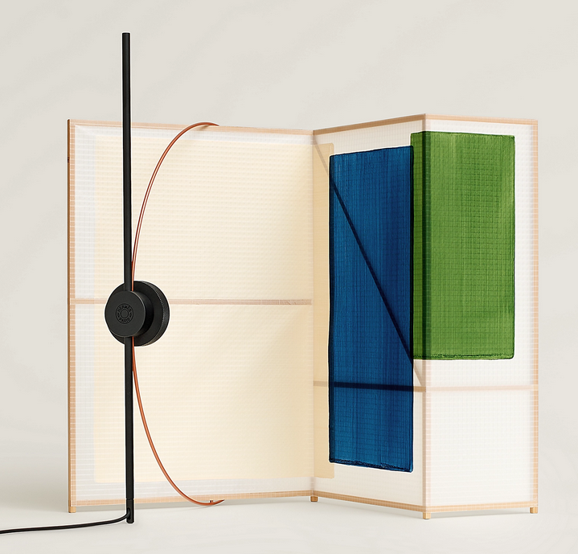
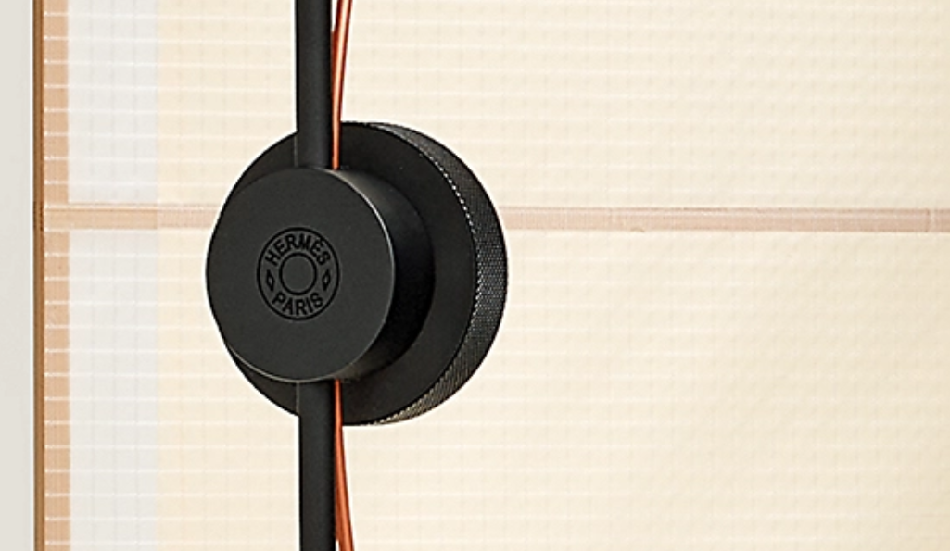

© 2026 Hermès of Paris, Inc. / Designer: Thomás Alonso
EUTM No. 19 161 595 “HERMÈS” (word), registered since 25 November 2025 for, inter alia, ‘virtual lamps’ in Class 9

Slide 4
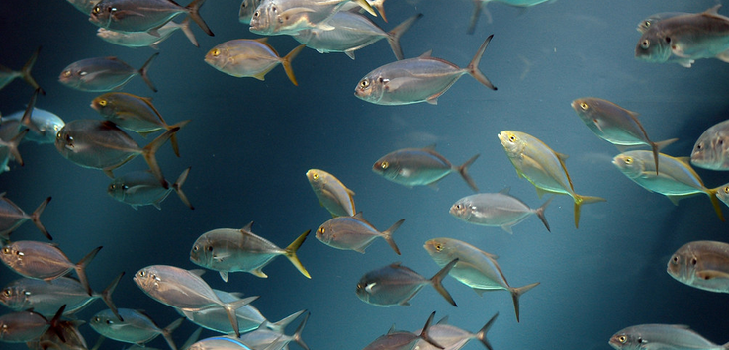
WHY?
"Georgia Aquarium Fish" by Mike Johnston is licensed under CC BY 2.0.

Slide 5

Inhouse
Office / Court
External lawyer
19/11/2025, T-563/24, Làv, § 74 ff.
Photo by Diva Plavalaguna: https://www.pexels.com/photo/people-holding-gray-puzzle-pieces-6147363/

Slide 6
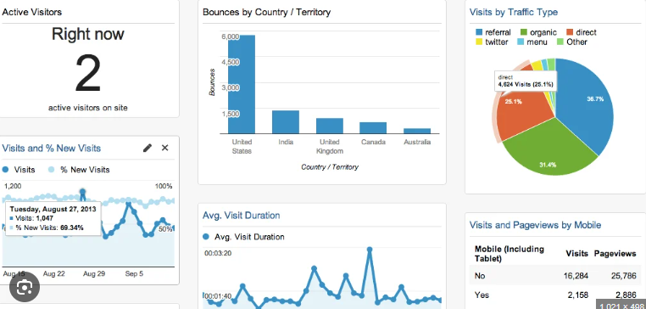
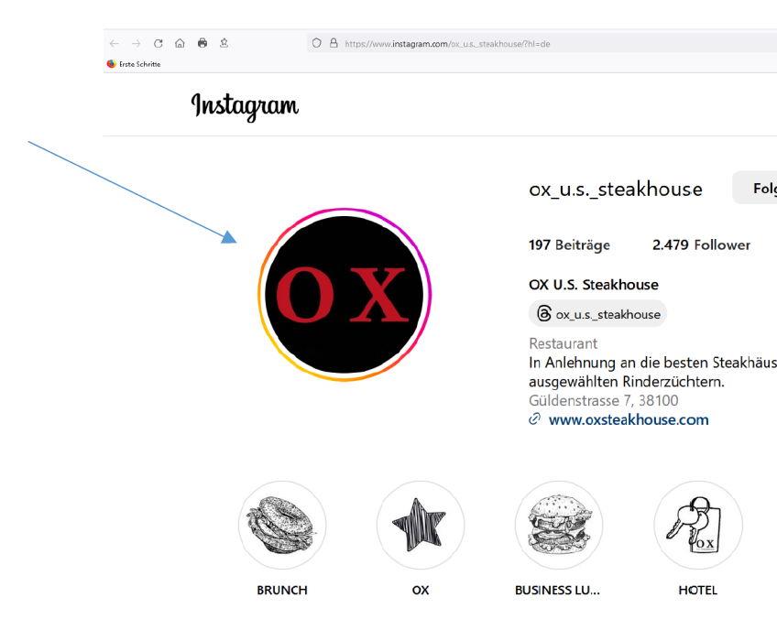
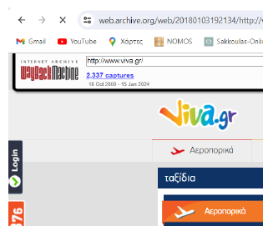
25/02/2026, T-73/25, Viva, § 100 ff.
25/02/2026, T-297/25, OX, § 73, 89

Slide 7
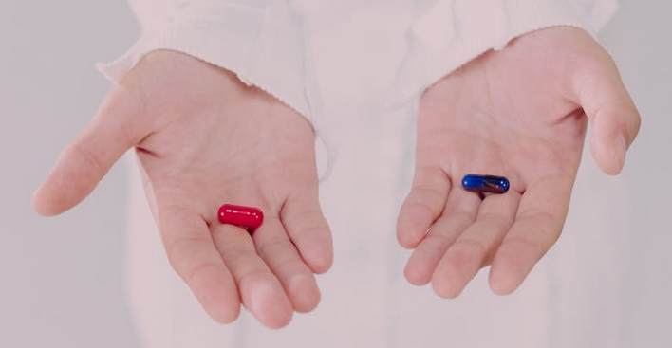
Evidence and ‚AI Hallucinations‘
LG Köln, 02/07/2025, 312 F 130/25: possible infringement of lawyer‘s obligation not to ‚knowingly disseminate untruths‘
Tribunale di Verona, 10/02/2026, 4203/2025 R.G.: aggravated procedural liability of opponent
Photo by Ron Lach from Pexels: https://www.pexels.com/photo/woman-holding-and-showing-pills-9761337/

Slide 8
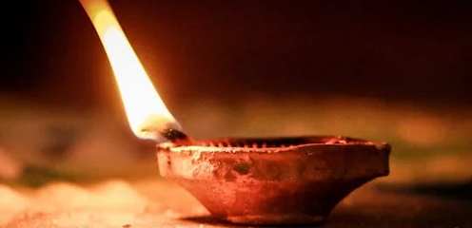
Conclusion: The perfect evidence – does it exist?
Photo by Aakash Chaudhary: https://www.pexels.com/photo/close-up-shot-of-a-lighted-candle-5897979/

Slide 9
THANK YOU

